Slide 1


Predicting the Outcome of KickStarter
Projects
GROUP __predictUs__()
Charu Rawat (cr4zy)
Karan Gadiya (khg8mh)
Ning Han (nh4mq)
Charishma Ravoori (cr2st)
August 8th 2018

Slide 2

AGENDA
Introduction
Dataset
Exploratory Data Analysis
Predictive Analysis
Testing
Conclusion

Slide 3
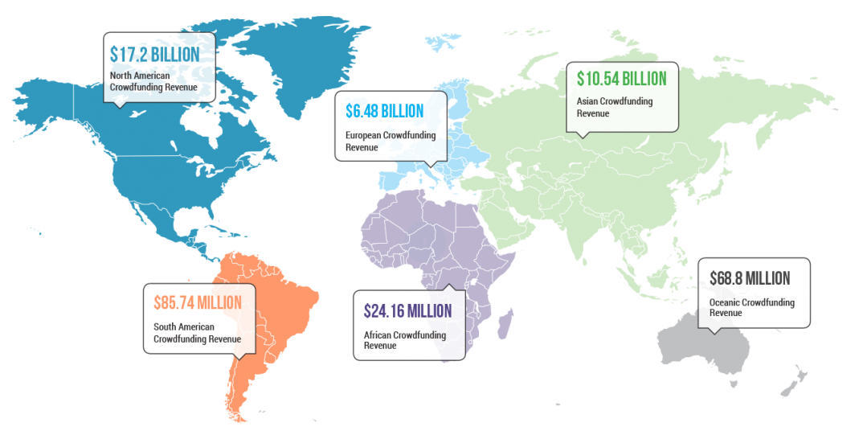

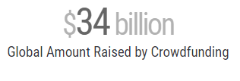

INTRODUCTION
.
The crowdfunding industry is projected to grow to over $300 billion by 2025.
191 platforms
400k campaigns → 150k Successful
Generated : $ 3.4 Billion
Notes:
Kickstarter is one of the most popular crowfunding platforms in the US. The steps to start a Kickstarter project are; start a campaign, set the minimum funding goal, set reward levels, and choose a deadline. To today, Kickstarter has around more than 15 million peoples and funded more than 148 thousand projects. It has a unique “All or Nothing” Model, meaning unless a project reaches its funding goal, no backer will be charged any pledge towards a project. As an exchange to their fund, backers in Kickstarter will only be rewarded in experience or creative products instead of equity.

Slide 4
Kickstarter has grown into one of the most popular crowd-funding platforms on the web since its inception in 2009. Over 140,000 projects have been funded thanks to the patronage of millions of Kickstarter backers. From documentaries to smart watches to card games about combustible felines (Exploding Kittens) , Kickstarter has brought to life ideas that have impacted technology, design, and pop culture.

Slide 5
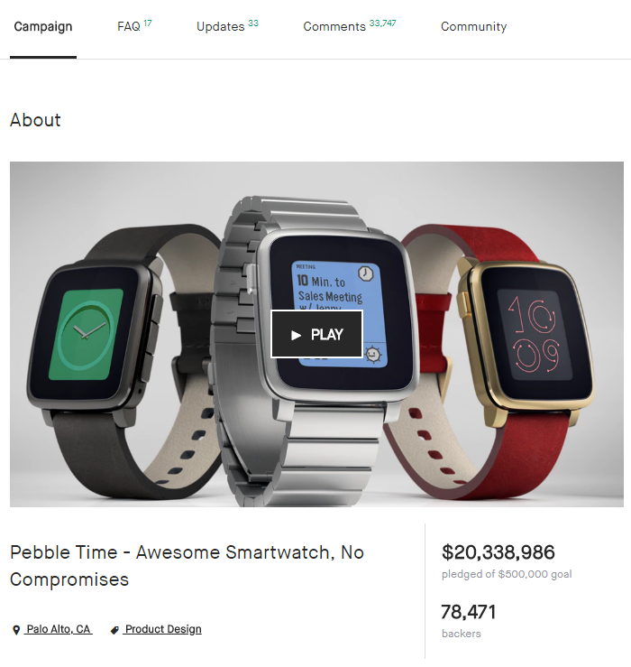
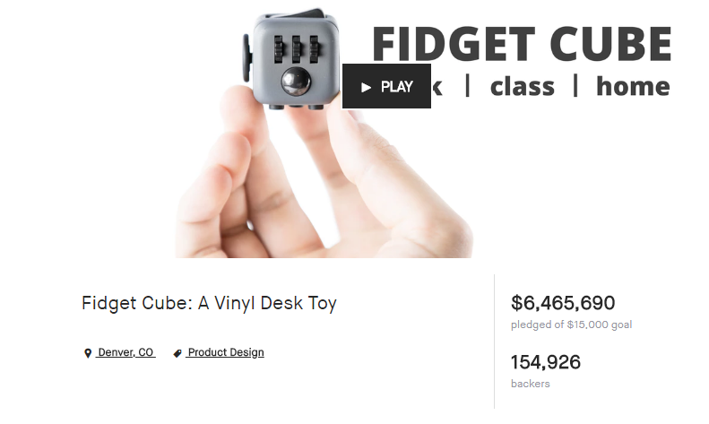
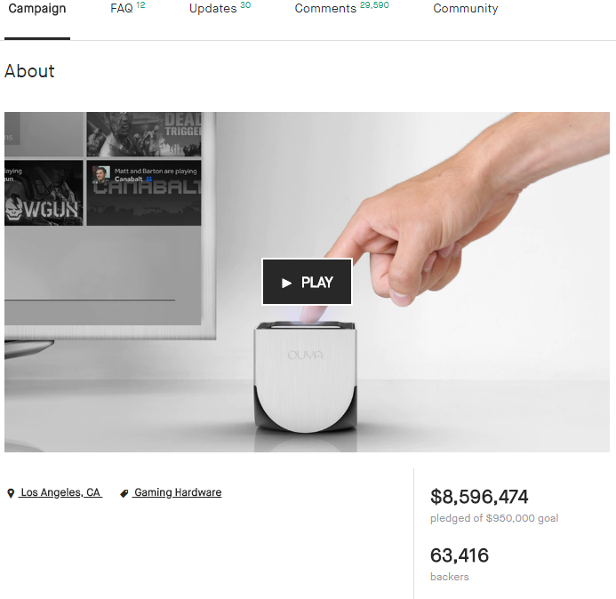
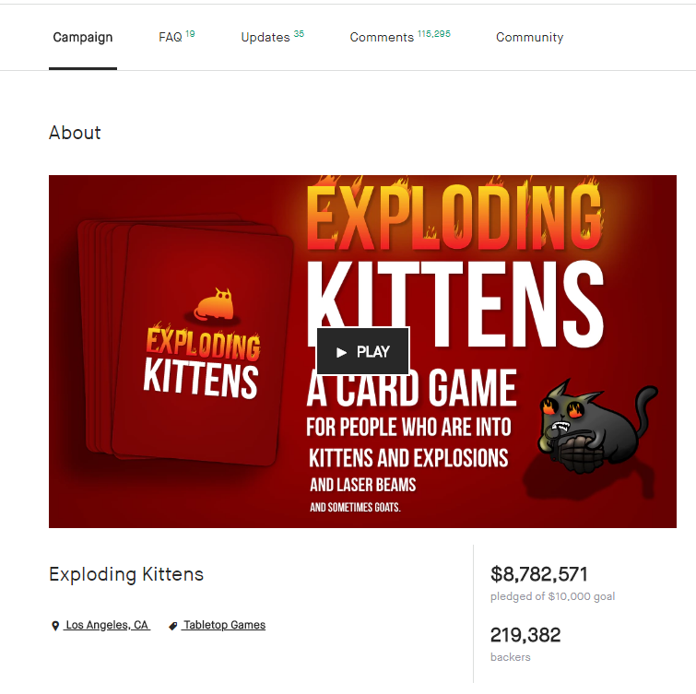

Slide 6
SUCCESS
36.29 %
What are the factors that contribute towards a project achieving its goal and getting fully funded. And can we know beforehand that a project is doomed to fail?
This Kickstarter dataset, provided by Kaggle, can give us an insight into Kickstarter projects launched between 2009 and 2017.
FAIL
3
Notes:
Why are some projects successful in kickstarter? why some or not? Do these successful projects share some common attributes? For our project, we want to uncover the trends behind the successful projects in kickstarter and use predictive models to predict whether a certain project would succeed or not on kickstarter.

Slide 7
DATASET
Columns | Description
ID | internal Kickstarter project id
name | Name of project - A project is a finite work with a clear goal that you’d like to bring to life. Think albums, books, or films.
category | Sub category of project
main_category | Main category of campaign ; 15 of them
currency | currency used in donating money to the project
deadline | deadline for the project
goal | The funding goal is the amount of money that a creator needs to complete their project.
launched | Project launch date
pledged | amount donated by people
state | current state of the project – success, fail, withdrawn
backers | people who back the project and donate to it
country | Country project originated in
usd pledged | amount of money pledged in USD
usd goal | goal amount in USD
Notes:
The original data set we used is from Kaggle.com. The dataset is called Kickstarter Projects. It contains the columns showed in this table. In our project, we decide only focus on projects launched in US. And since we only interested in projects with status of either successful or failed, we removed the projects with status of other three levels. We also dropped few unnecessary columns that we don’t need for our project analysis. The rows shaded grey in this table on the columns we dropped. . At the end, we only kept nine columns from the dataset, which are ID, category, main category, state, deadline, launched, goal, pledged and backers.

Slide 8
DATASET
The original dataset sourced from Kaggle contained 15 columns each corresponding to an attribute and roughly 378k rows in total. For our analysis, we did perform some pre-processing on the data before leveraging it to gain any insight. We have primarily focused on Kickstarter trends just in the US.
The final data obtained consisted of 14 columns and roughly 260k rows which we stored into a pandas data frame and queries from for our exploratory analysis.
Notes:
The original data set we used is from Kaggle.com. The dataset is called Kickstarter Projects. It contains the columns showed in this table. In our project, we decide only focus on projects launched in US. And since we only interested in projects with status of either successful or failed, we removed the projects with status of other three levels. We also dropped few unnecessary columns that we don’t need for our project analysis. The rows shaded grey in this table on the columns we dropped. . At the end, we only kept nine columns from the dataset, which are ID, category, main category, state, deadline, launched, goal, pledged and backers.

Slide 9

EXPLORATORY DATA ANALYSIS
Summary Data between Successful and Failed Projects from 2009 to 2017
 | FAIL | SUCCESS | TOTAL
Number of Projects | 152061 | 109299 | 261360
Proportion | 58% | 42% | 100%
Number of Backers(avg) | 16.77 | 270.18 | 122.74
Number of Backers(std) | 73.43 | 1593.15 | 1039.32
Duration(days avg) | 35.48 | 32.39 | 34.19
Duration(days std) | 13.51 | 12.03 | 13
Goal(avg) | $60,664.24 | $9,695.67 | $39,349.53
Goal(std) | $1,356,864.41 | $28,790.07 | $1,035,436.64
Pledged(avg) | $1,331.17 | $23,212.89 | $10,481.96
Pledged(std) | $6,999.57 | $160,709.99 | $104,622.74
Notes:
our dataset contains more failed projects (58%) than successful projects (42%). The average number of backers (271) of the successful projects is significantly higher than that (17) of the failed projects. In generally, successful projects asked less and achieved more than failed projects.

Slide 10
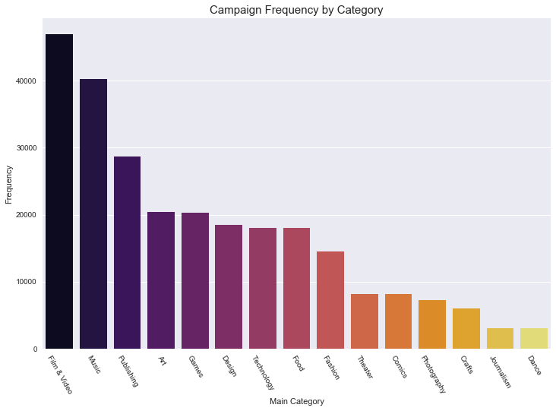
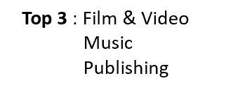
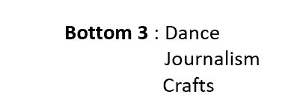
EXPLORATORY DATA ANALYSIS
Successful and Failed Projects by Categories
Notes:
, the top 3 most popular main categories of Kickstarter projects were Film& Video, Music and Publishing, while dance, journalism and crafts had the least project counts in the total 15 main categories with less than 10k projects for each category. When we looked at the popularities of the subcategories in these Kickstarter projects in Figure 2.2, product design which was one of the subcategories of design was the most popular subcategory in our dataset, with almost 14k project counts.

Slide 11
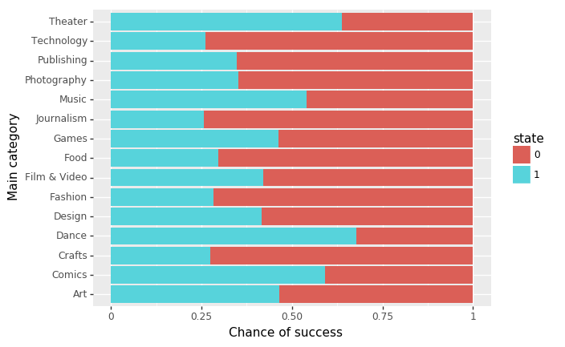
Successful and Failed Projects by Categories
Not all Kickstarter campaigns have the same shot at success. Projects in the Dance and Theatre category experience more success compared to others. The most popular category is not necessarily the most successful one.
Notes:
However, the most popular categories were not the most successfully ones. The top 3 main categories with most successful project rate were dance, theater, and comics as showed in Figure 2.3. Projects in Technology, Journalism and Crafts categories were least likely to reach their goal based on our dataset.

Slide 12
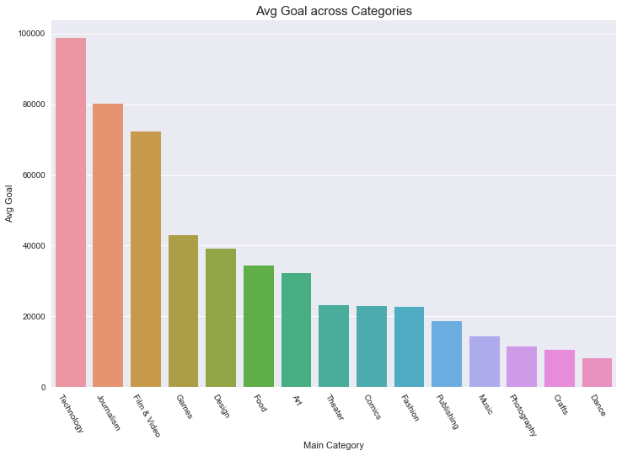
EXPLORATORY DATA ANALYSIS
Project Details by Categories
Categories which do experience more success generally have a modest goal. Categories like Journalism and Tech have high goals understandably but also have the lowest odds of being successful as seen from the previous chart.
Notes:
The average amount of goal setted by the requesters varies siginificantly across 15 categories. Technology had the highest average goal, appromiaxiately 100k, while the lowest aveage goal for main category Dance was less than 10k.

Slide 13
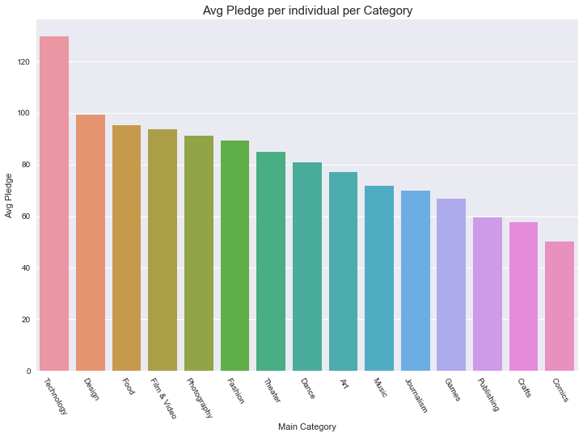
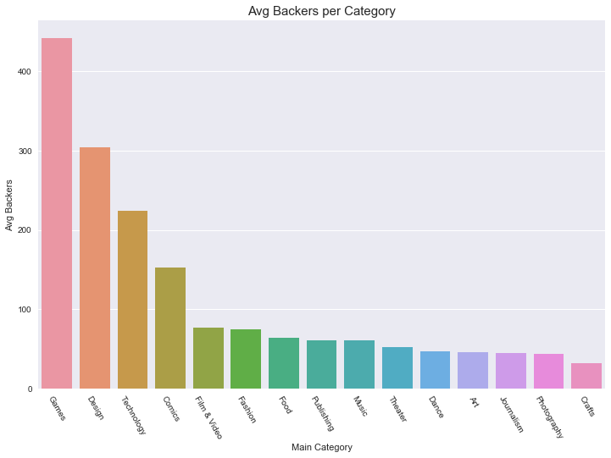
EXPLORATORY DATA ANALYSIS
Project Details by Categories
Notes:
Technology also had the highest average pledged per individual, with more than $ 120 per backer. The second highest category design had around $100 per backer.
. Backers in most other categories funded similar average mount per person, while people who financed comics projects gave the least amount per person, which is around $50. Despite projects in the games category had the most average backer, more than 400 per project, technology and design also had a great average amount of backers per project, 220 and 300 respectively. Projects related to art subject were less likely to have many backers

Slide 14

WE DONATE MORE !
Notes:
Technology, game , design get more backers and backers back them like to donate more in average !

Slide 15
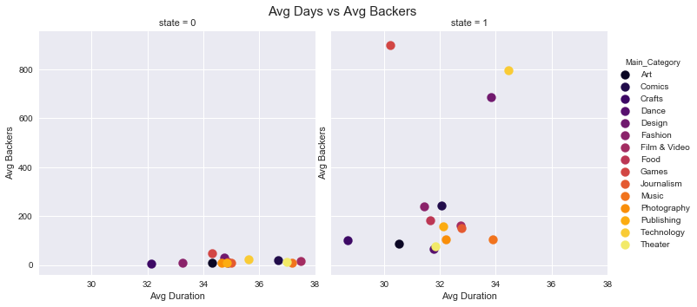
EXPLORATORY DATA ANALYSIS
Project Details by Categories
Notes:
The last chart showed that successful projects took shorter time to be completed than failed projects in the same category. It also showed that game projects completed fastest(around 30 days) among the top 3 categories that had the most average backers (games, technology, design).

Slide 16
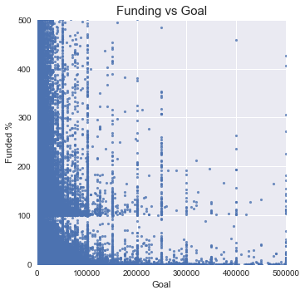

EXPLORATORY DATA ANALYSIS
The Impact of Goal Amount on Success and Fail
Notes:
Does a higher goal decrease your project’s success rate on Kickstarter? The following figure shows that the higher the goal was in our dataset; the less proportion of its goal would be funded. Most projects with a goal that under 50k achieved their goal and a lot of them received more than they expected, however, projects with a goal higher than 100k, were barely achieve their goal and merely none of them received funding more than they expected.
Don’t be greedy!!

Slide 17
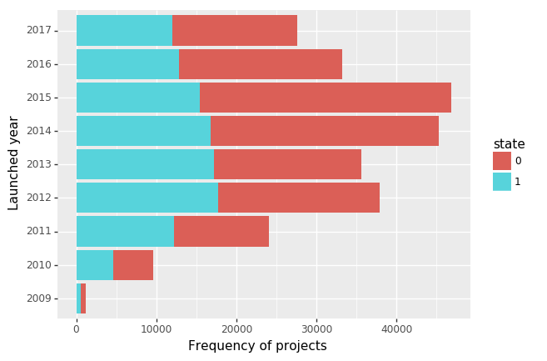
EXPLORATORY DATA ANALYSIS
Time Impacts on Success and Fail
Notes:
the number of projects increased since 2009 and reached the highest point at around 45k, in 2015, however, the success rate in each year followed an opposite trend, which decreased over years and reached its lowest point at 2015. There were less projects launched during recent two years, however, the projects launched in 2016 and 2017 were more likely to be successful compared with 2015.

Slide 18

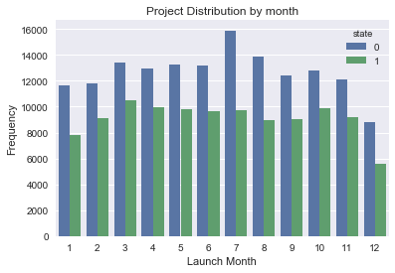
EXPLORATORY DATA ANALYSIS
Time Impacts on Success and Fail
Notes:
. As for the month factor, projects posted in July were least likely to be successful. Projects launched in April, October and December have better chances to be successful.

Slide 19
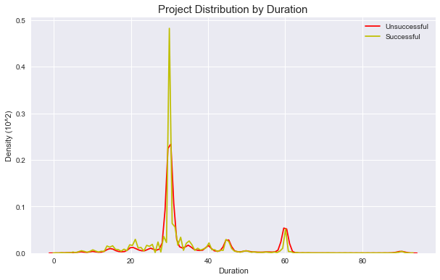
EXPLORATORY DATA ANALYSIS
Time Impacts on Success and Fail
Notes:
.Overall a project needs about 30 days(duration) to reach the result. There is not much difference in average project duration between successful projects and failed projects. However, around 50% successful projects achieved their goal in 30 days while failed projects usually had longer deadlines.

Slide 20

PREDICTIVE ANALYSIS
Notes:
Due to Kickstarter’s “All or Nothing” model, what forms the core of this analysis is the end result of a project – success or failure. Keeping that goal in mind, we built a couple of predictive models to classify a project as a success or failure based on certain attributes. In this case, we used the following attributes to determine the end status of the project based on the relationships discovered between in the exploratory data analysis. The following attributes were used as our independent variables in predictive modelling - ‘main category’, ‘category’, ‘launched month’, ‘deadline month’ , ‘goal’, ‘duration ’ ; all that are set by the user on initiating a project on Kickstarter.

Slide 21
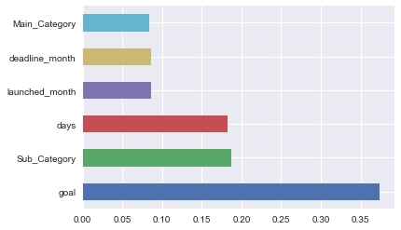
PREDICTIVE ANALYSIS
Significant Variables

Slide 22
PREDICTIVE ANALYSIS
 | Accuracy | Area under ROC
Random Forest | 63.15% | 0.615
Logistic | 59.83% | 0.538
kNN | 59.83% | 0.606
Notes:
Prior to implementing the classification techniques on our data, we encoded categorical variables such as main category and sub category and divided our data into train and test using a 77-33 split. The classification models that we implemented were - Logistic regression, Random forest and kNN . Amongst the 3 models, we found Random Forest to be the most suitable fit for our data because of a relatively higher accuracy rate and a higher area under the ROC curve. The Random Forest method (with 100 estimators) took comparatively less time to run than kNN.

Slide 23
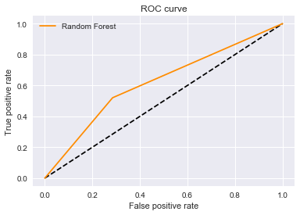
PREDICTIVE ANALYSIS
Random Forest Classifier

Slide 24

Testing

Slide 25
Test for importing data
Test the data structure
Test for filter
Test for removing unused categories
Test for writing into a csv file
Notes:
To start the testing, we imported the unittest package in python and created a class with methods that tested each of the functionalities in the code. The first method, test_for_file(), tests whether the .csv file containing our Kickstart data was loaded into the assigned variable correctly. It does this in two ways. First it extracts all the column headers in the dataset and uses the assertEqual() statement to check it against the expected result. Then it uses the assertTrue() method to check if the length of the loaded set is the same as that of the original file.

Slide 26
Conclusion
We have been able to leverage this data to gain insight into Kickstarter project outcomes and understand that there are many nuances to the outcome or the success of a project and it’s not just about size of a project or the general popularity of the domain under which it falls.
Some of the main and specific takeaways from our analysis are :
Projects that achieve success generally have a duration of 32-38 days.
Projects that have a goal set to < $ 50k have better chances of being funded and even being overfunded up to 5 times it’s goal.
Projects in the artistic space such as Dance, Music, Theatre have better odds of succeeding owing to the shorter duration and modest goals set.
Projects in categories such as Tech, Design are harder to fund despite having a larger base of backers owing to high goals set for such projects. Having said this, such projects that have a modest goal will have an excellent chance to succeed, owing to these same characteristics.
The data does have predictive power. Our model using random forecast classification yielded an accuracy rate of 63% in predicting the outcome of projects.

Slide 27
Conclusion
We would like to do the following to enhance our analysis and improve our accuracy in predicting the outcome of projects on Kickstarter-
Source data that contains more attributes which can help predict better such as project origin city, social media tags, user history, project description which based on our research correlate strongly to project outcomes.
Leveraging advanced feature engineering and techniques of classification.
Robust validation in determining model performance.
Handle outlier detection in a sophisticated way.
Further functionality -> Predict the time that a project can take to achieve it’s goal. To also predict the number of backers a project would require to meet its funding requirement.
Our analysis would be useful to -
People or Creators who want to check how their project or campaign can perform on Kickstarter before they invest time and efforts in launching it on the website. And to be able to accordingly adjust project specs and goal which could help the maximize their chances of success.
People or Backers who want to determine the outcome of project based on it’s current state before they commit to donating money.

Slide 28

Q&A

Slide 29
Thank you!

